Slide 1
BODY MASS INDEX (BMI)
Presentation By
Dr. DEEPIKA ANAND

Slide 2
INTRODUCTION
NUTRITIONAL STATUS :The definition of nutritional status is: the condition of the body as a result of the intake, absorption and use of nutrition, as well as the influence of disease-related factors.
The nutritional status of an individual is often the result of many inter-related factors.
It is influenced by food intake, quantity & quality, & physical health.
The spectrum of nutritional status spread from obesity to severe malnutrition

Slide 3

What are the Methods to Assess Nutritional Status ?
Direct method
Indirect method

Slide 4
Direct Methods of Nutritional Assessment
These are summarized as ABCD
Anthropometric methods
Biochemical, laboratory methods
Clinical methods
Dietary evaluation methods

Slide 5
Indirect Methods of Nutritional Assessment
These include three categories:
Ecological variables including crop production
Economic factors e.g. per capita income, population density & social habits
Vital health statistics particularly infant & under 5 mortality & fertility index

Slide 6
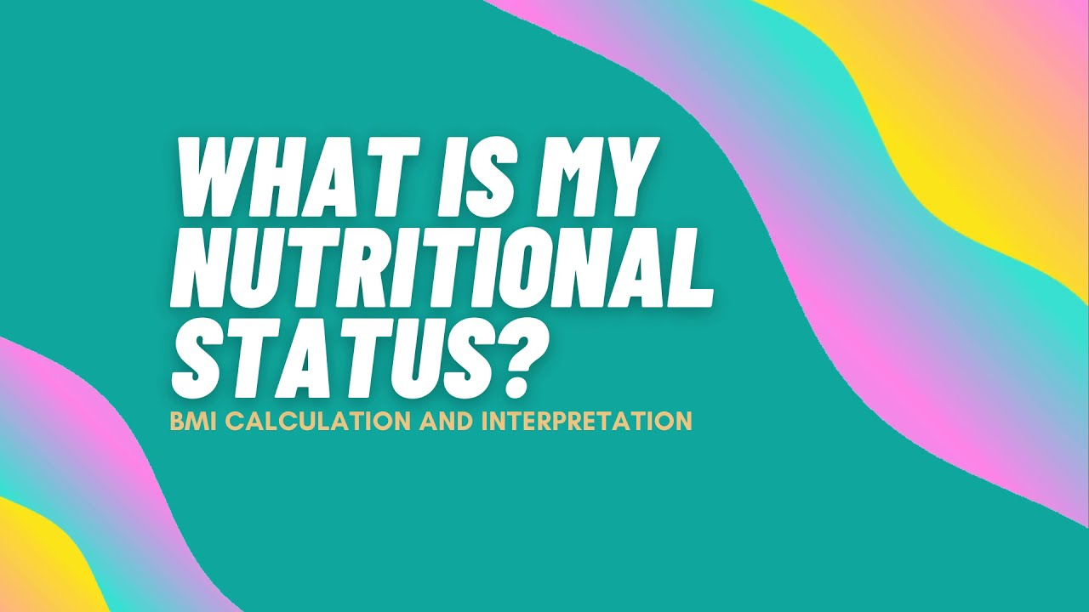

Slide 7
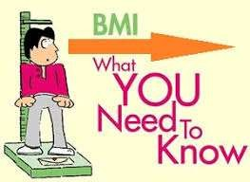



It is a measure of body fat based on your weight in relation to your height.
It is more of an indicator than a direct measurement of a person’s total body fat.
As the BMI score increases, so does the person’s total body fat increases.

Slide 8
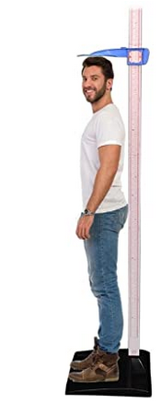

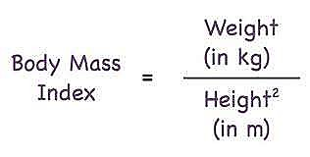
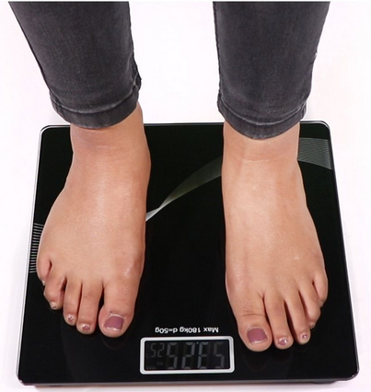
· Formula –
Example- For an adult with height of 180 cm and weight of 75 kg.
First step is to convert the height into meters. As there are 100cm in a meter, we divide our figure by 100. This gives us 1.8m.
BMI = 75 ÷ (1.8 x 1.8)
BMI = 75 ÷ 3.24
BMI = 23.15
WEIGHING SCALE
HEIGHT SCALE

Slide 9
BMI Cutoff Levels (WHO, 2010)
Weight Status | Body Mass Index kg/m²
Under weight | <18.5
Normal range | 18.5-24.9
Over weight | 25.0-29.9
Grade 1 obesity | 30.0-34.9
Grade 2 obesity | 35.0-39.9
Grade 3 obesity | ≥40

Slide 10
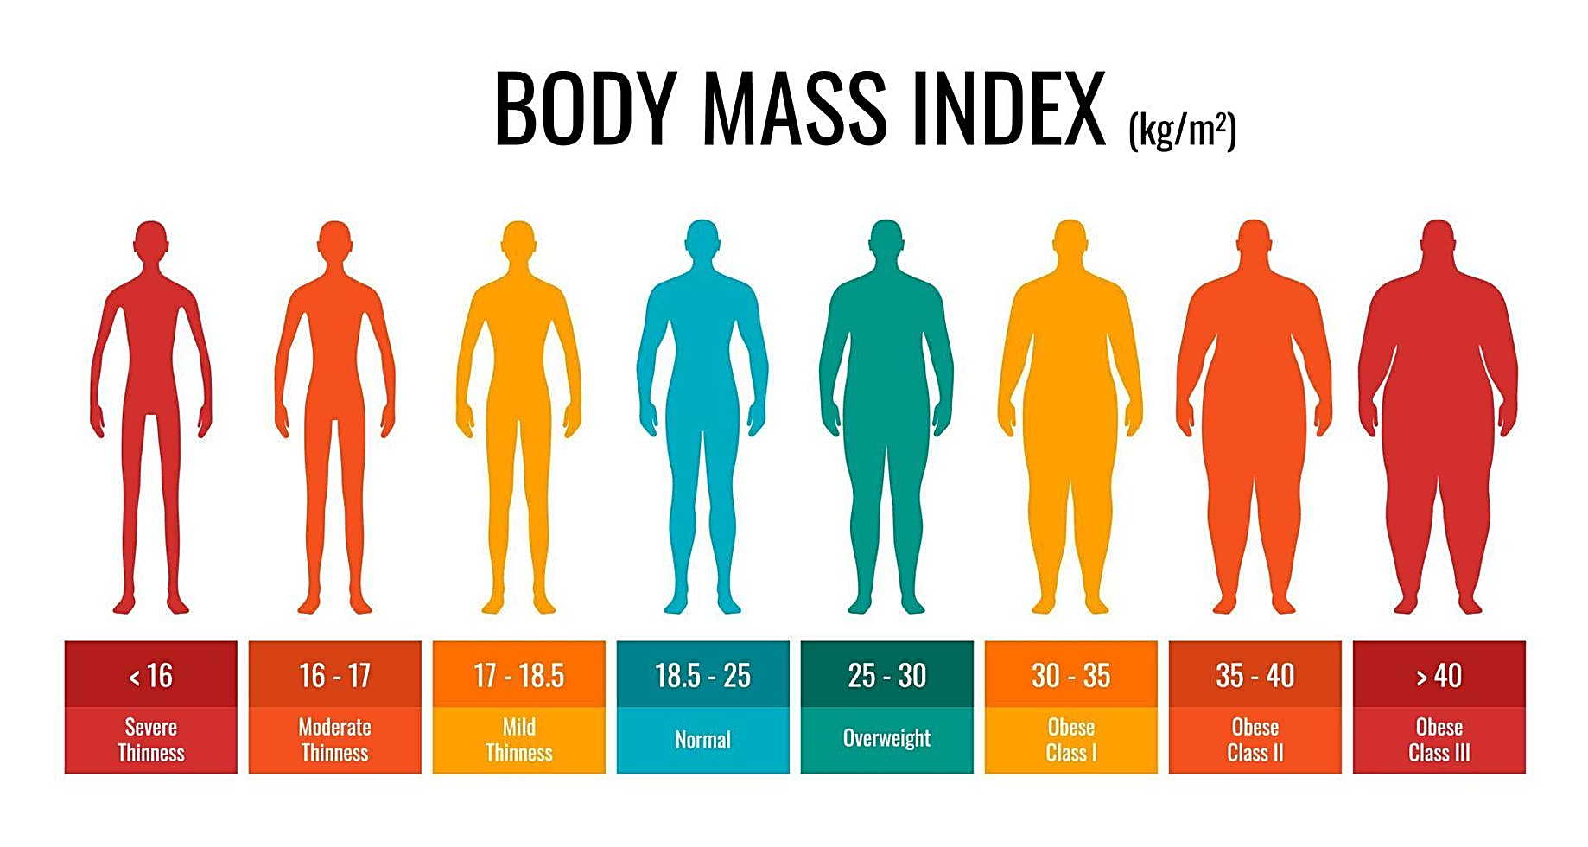
< 16
16 - 16.9
17 - 18.4
18.5 - 24.9
25 - 29.9
30 - 34.9
35 - 39.9
> 40

Slide 11
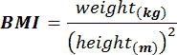
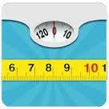
The BMI is universally expressed in kg/m², resulting from mass in kilograms and height in metres.

Slide 12
BMI CLASSIFICATION (WHO,2010)
Weight Status | Body Mass Index kg/m²
Under weight | <18.5
Normal range | 18.5-24.9
Over weight | 25.0-29.9
Obese | ≥30
Obese class - 1 | 30.0-34.9
Obese class - 2 | 35.0-39.9
Obese class - 3 | ≥40

Slide 13
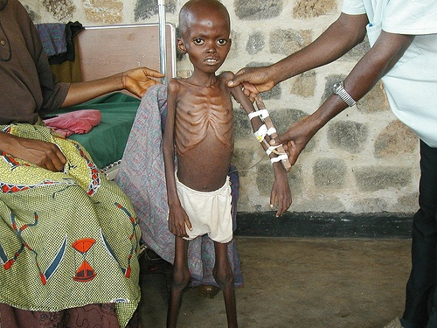
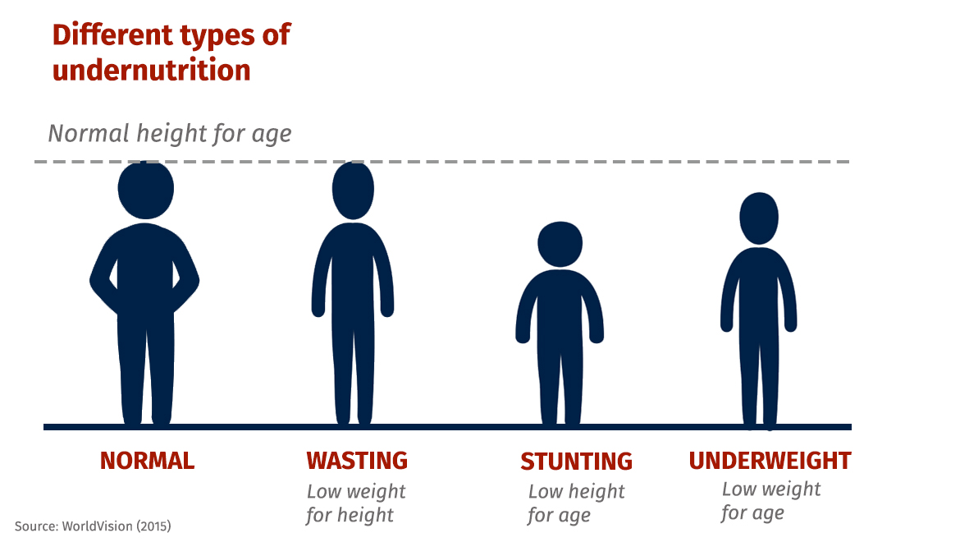
INTERPRETATION
Underweight (BMI of less than 18.5)
Undernutrition
Eating disorder
Other health problems

Slide 14
The higher the BMI, the greater is the risk of certain diseases, including
Hypertension (High Blood Pressure)
Cardio Vascular Diseases (CVD)
Gallbladder disease
Breathing problems
Dyslipidemia
Stroke
Osteoarthritis
Certain cancers–breast, colon etc.
Type 2 diabetes

Slide 15
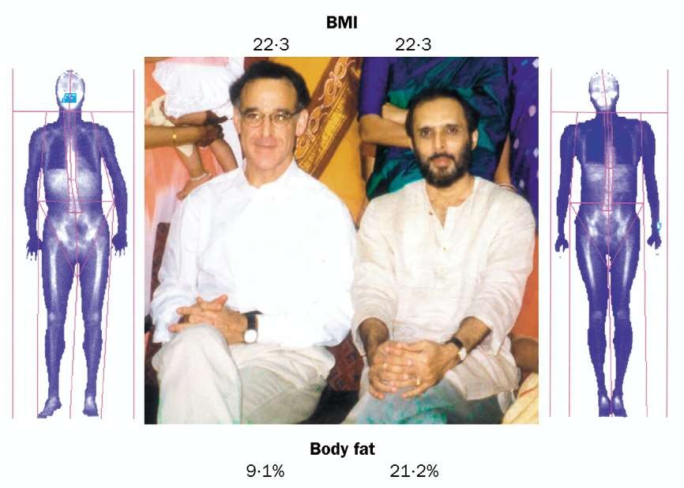

Slide 16
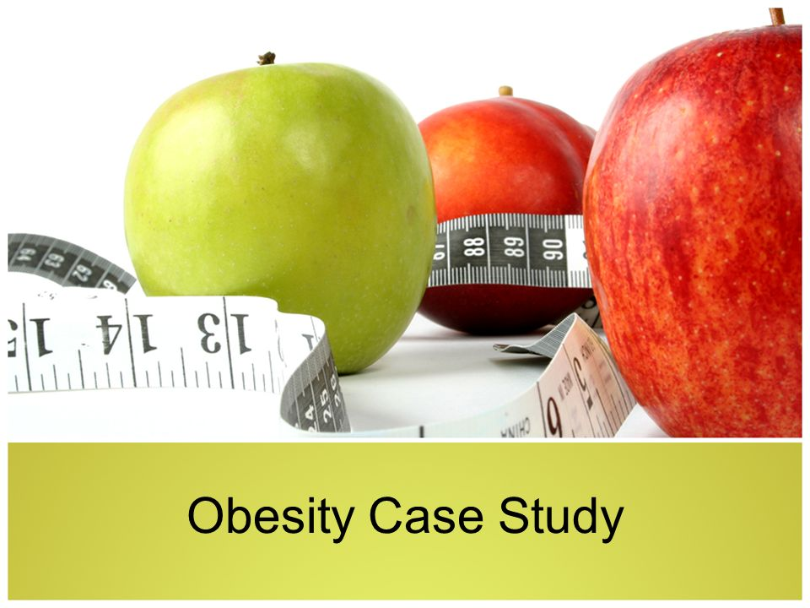

Slide 17
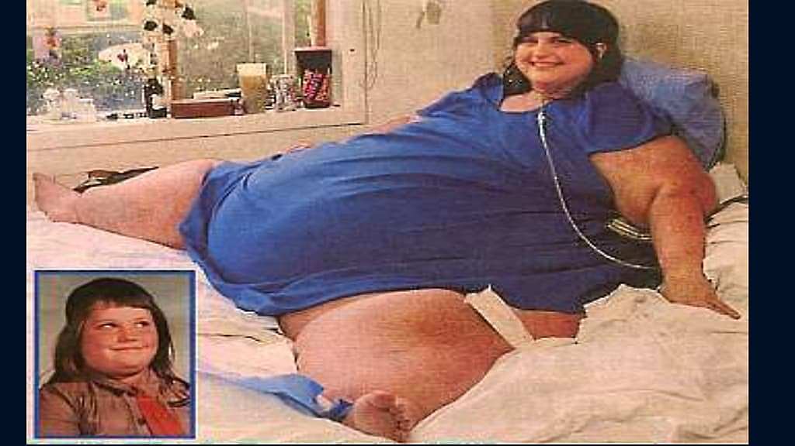
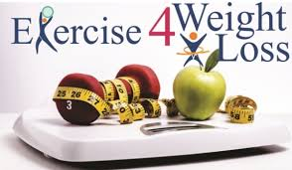

Slide 18
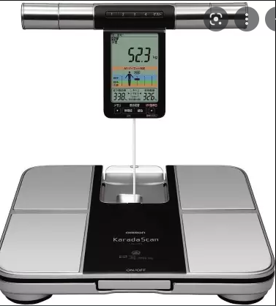
Fat Analyzer
Aside from the body fat, body fat analyzer is also able to analyze the following:
BMI – This is the ratio of your body fat to your weight and height
Obesity degree – This option tells you how much weight you can add to be obese
Protein percentage – This is the percentage of your body that is composed of proteins.

Slide 19
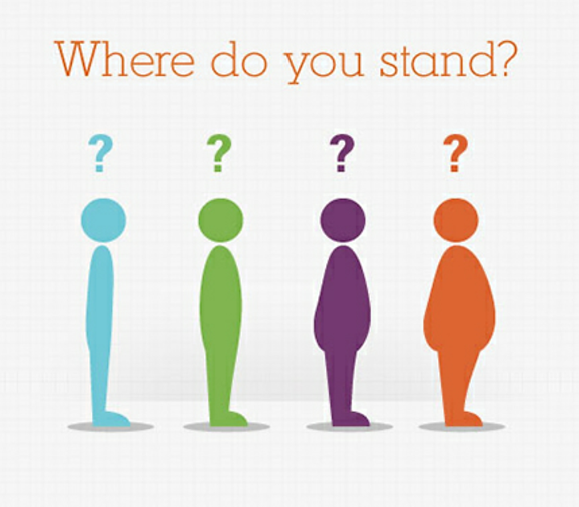
CHECK YOUR BMI ON YOUR OWN ?

Slide 20
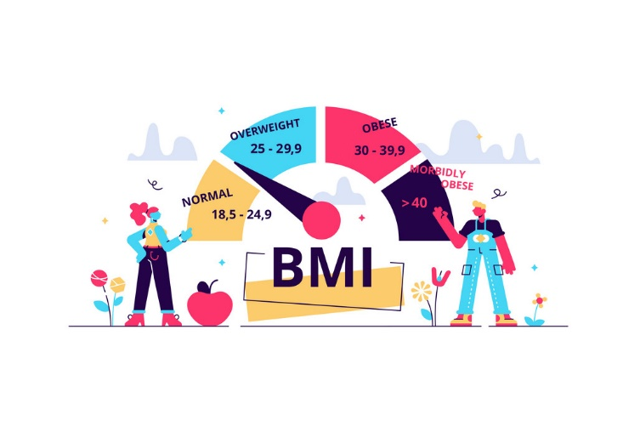
Track Nutritional Status…..

